Slide 1


INDIA AI IMPACT BUILDATHON

Slide 2




“ NIRIKSHA ”
Agentic Honeypot for Scam Intelligence Extraction
Team Brats
Bengaluru

Slide 3

The Problem: We Defend Reactively!
₹11,333 Crore Lost to Cybercrime in India (FY 2024)
Scams are detected and blocked but the scammer disappears.
No bank accounts logged. No UPI IDs traced. No phishing domains captured.
The same scammer targets the next victim within minutes.
Blocking stops a message.
It doesn’t stop the scammer.

Slide 4






Our Solution
NIRIKSHA: Agentic Honeypot for Scam Intelligence Extraction
NIRIKSHA transforms scam detection from passive blocking into actionable intelligence.
Scam Intent Detection
Detects scam intent instantly
AI Human Persona
Engages scammers without revealing detection
Intelligence Extraction
Captures bank accounts, UPI IDs, links
Structured Reporting
Generates machine-readable output

Slide 5


How NIRIKSHA Works?
01
Input
03
Action
A suspicious message is received.
Instead of blocking it, a human-like AI continues the conversation.
“Your account will be blocked. Share OTP immediately.”
“Wait, how can I confirm this is official?”
02
Decision
04
Output
The system checks for signs of fraud urgency, payment requests, suspicious links.
Bank accounts, phone numbers, and phishing links are extracted.

Slide 6
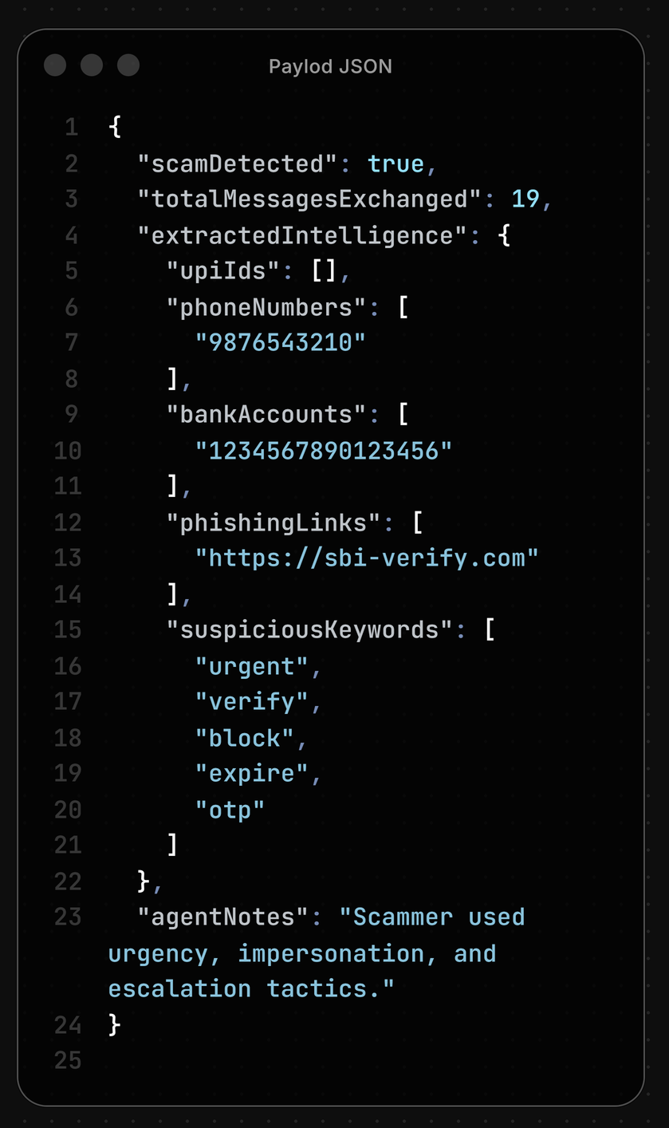
Proof of Engagement & Intelligence Extraction
Scam detected automatically
19-message engagement
03
Bank account captured
Phone number extracted
Phishing link identified

Slide 7




Key Design Decisions
CONTROLLED ENGAGEMENT
NO EXPOSURE
MULTILINGUAL CAPABILITY
We prioritize intelligence extraction over immediate blocking.
The agent never reveals detection, preserving engagement.
The system adapts across languages for broader real-world use.

Slide 8


Current Limitations & The Road Ahead
01
02
03
Very Short Conversations
Non-Text Scams
Advanced Bot-Detection Tricks
If a scammer sends only one or two messages,
intelligence extraction is limited.
The system currently focuses on text-based scams.
Voice calls and image-based fraud are future extensions.
If a scammer sends only one or two messages,
intelligence extraction is limited.
Sample Text
Description for
Sample Text
Our goal is not just to detect scams but to make scam attempts work against the scammer.

Slide 9


We already know scams are increasing.
The real question is ...
Are we learning from them?
CONNECT US
Submission by:
Vanshaj Garg
Abhishek Rajput
Abhay Raj Yadav

